Slide 1
Defensive Security Project
by: [Mutasem Ayyoush]

Slide 2
Table of Contents
This document contains the following resources:
Monitoring Environment
Attack Analysis
Project Summary & Future Mitigations

Slide 3

Monitoring Environment
‹#›

Slide 4
Scenario
Virtual Space Industries (VSI) is a company that specializes in the designs of virtual-reality programs for businesses
We have been tasked as SOC Analysts to monitor against potential attacks using Splunk
Products that we have been tasked with monitoring include:
Windows OS, which runs many of VSI’s back-end operations
Apache web server, which hosts the administrative web page
Our Networking team provided us with past logs from both, Windows and Apache to help develop reports, alerts, and dashboards to protect VSI from any potential attacks
Three days after we have been assigned to monitor VSI’s logs, Jobecorp, one of VSI’s competitor was rumored to be the company that launched an attack on VSI’s systems.
The attack targeted severals systems including the Windows OS and the Apache web servers that we were monitoring.

Slide 5
[Website Monitoring App]
‹#›

Slide 6
[Website Monitoring]
Website Monitoring is a process that analyzes a web application or URL’s efficiency along with ensuring that the website is accessible.
It makes sure that the web application or URL is operating properly 24/7
It keeps a record of the amount of time the URL takes to respond in order to ensure that it is functioning effectively.
It provides a method for authenticating the response to ensure that the website is displaying real resources when they are presented.

Slide 7
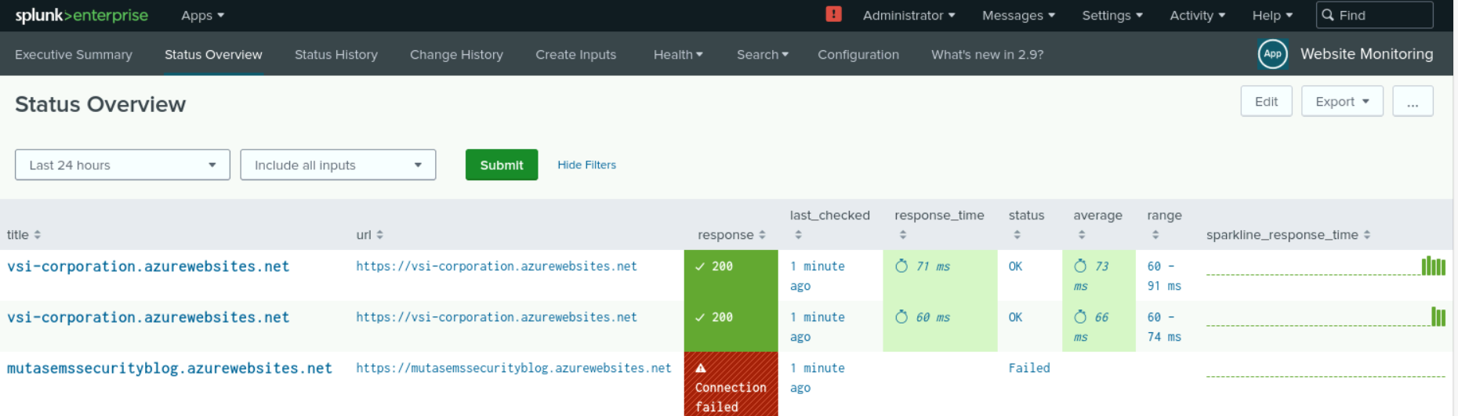
[Website Monitoring]

Slide 8
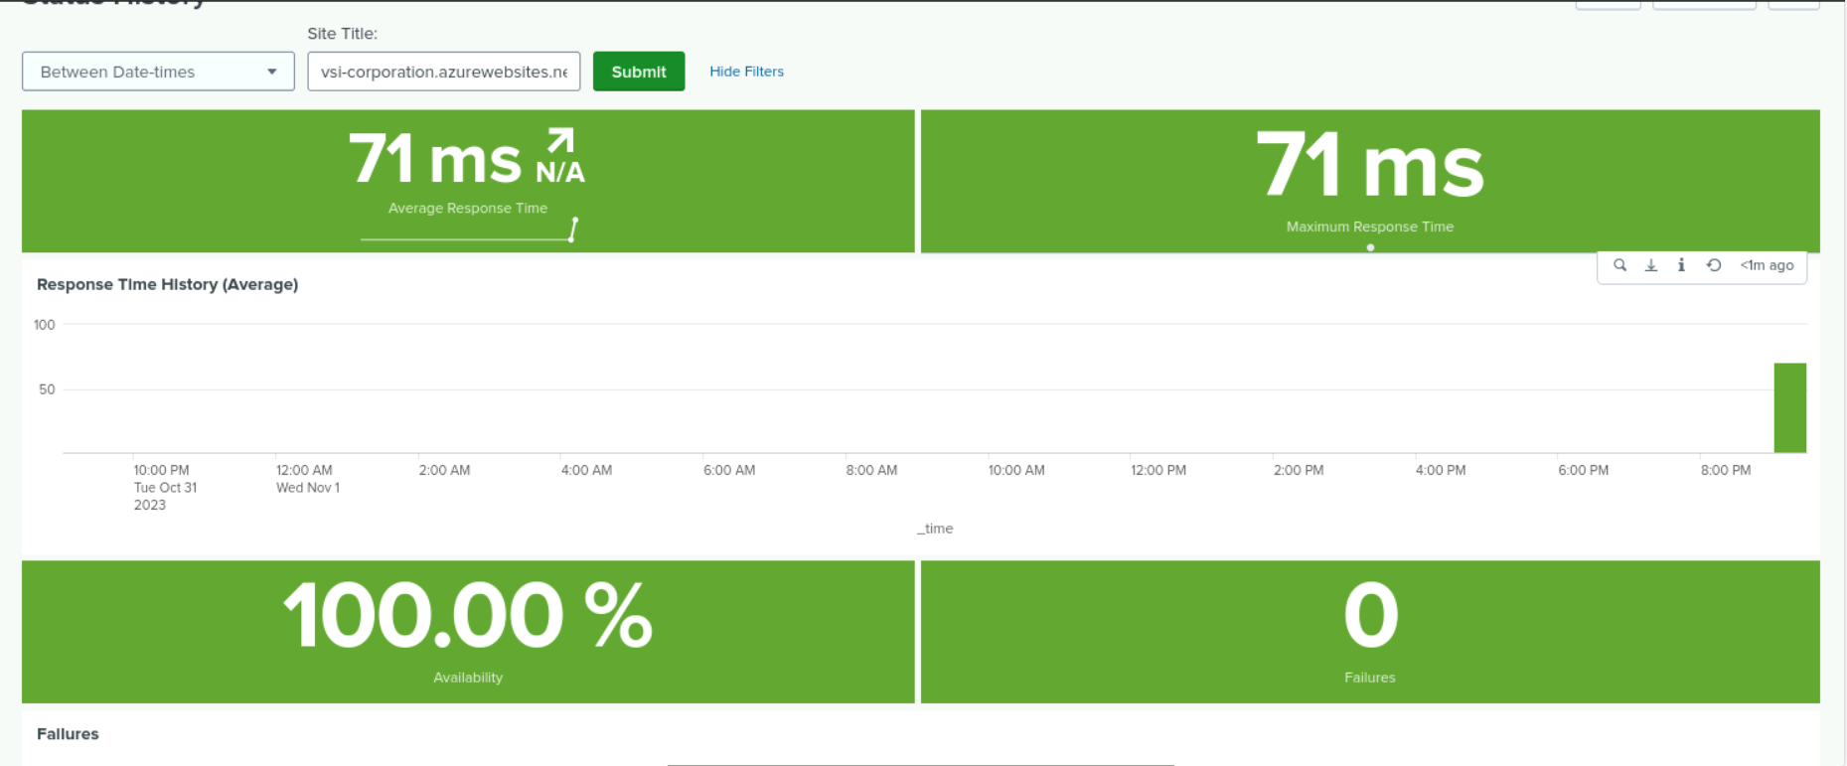
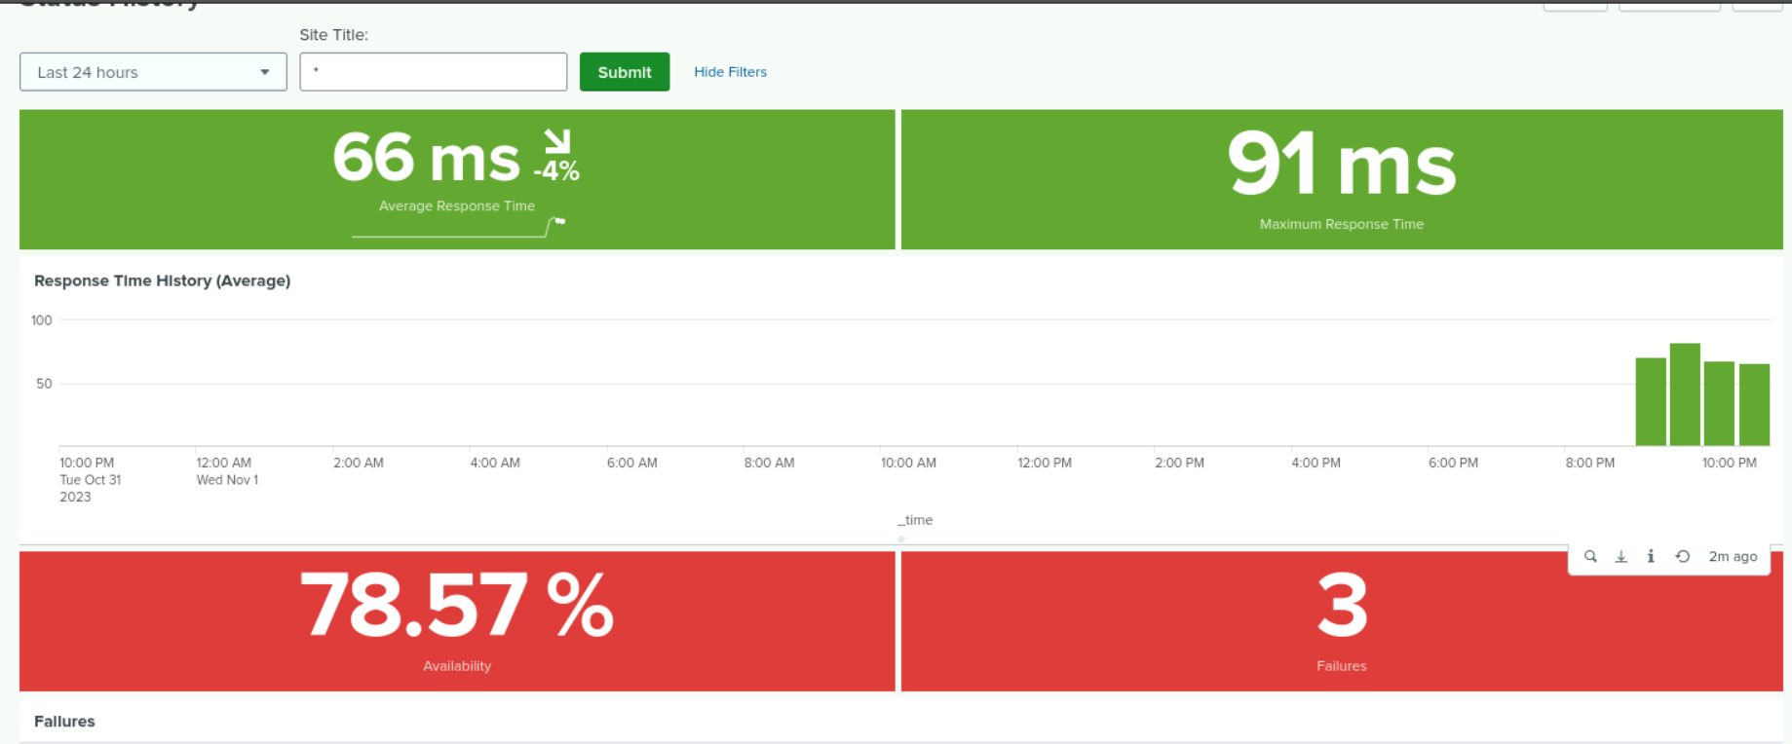
[Website Monitoring]

Slide 9
Logs Analyzed
Windows Logs
Apache Logs
1
2
The logs include information of the users activity on the server such as login status which indicates a success or failure and any modifications made by the user and severity levels.
The logs contain data of IP addresses that are connected with the server. IP addresses that connect to the website,and how the website responds to various IP’s, and the request of the server that identifies the browser.

Slide 10
Windows Logs
‹#›

Slide 11
Reports—Windows
Designed the following reports:
Report Name | Report Description
Signature and Signature ID | Displays the activity of logged in users as well as their associated ID number for each hour
Severity Levels | Shows the total count of examination logs to understand the level of impact
Success and Failure | Displays how many users were locked out and successfully logged in each hour

Slide 12
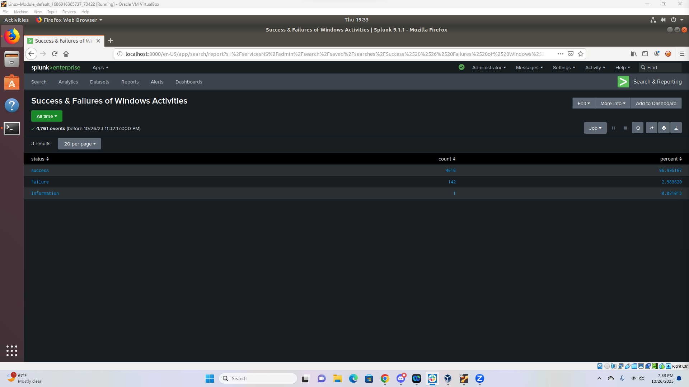
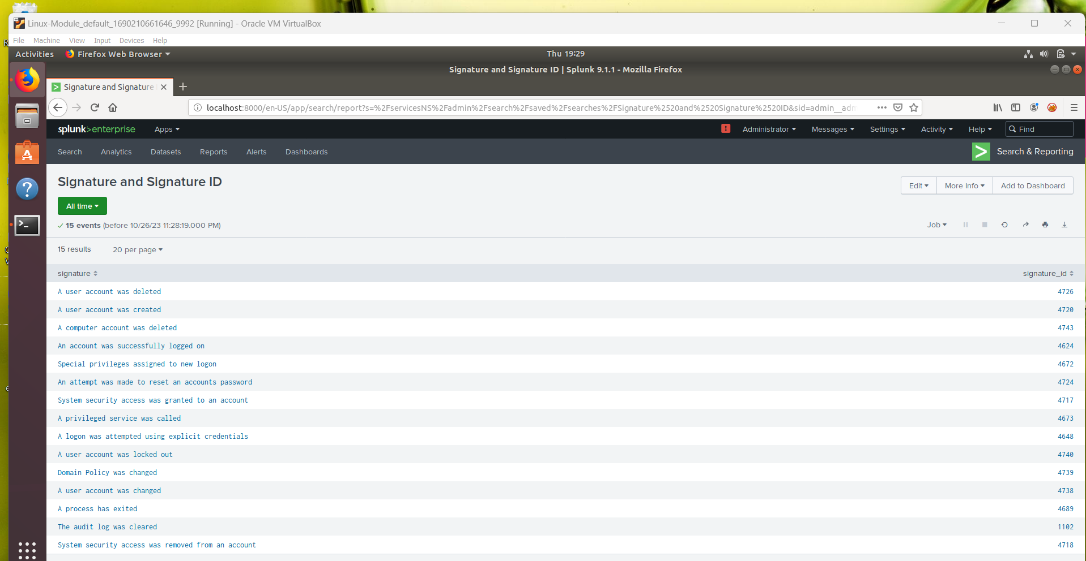
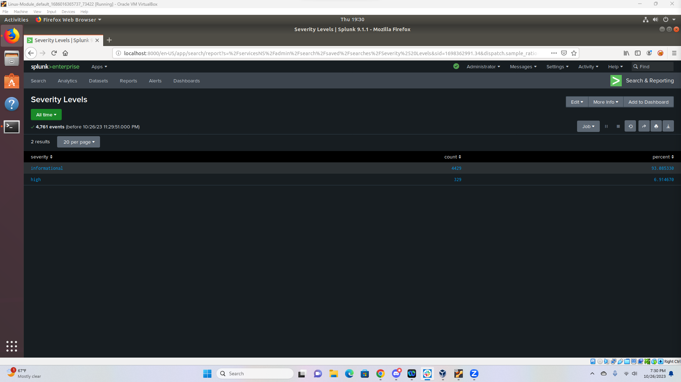
Images of Reports—Windows
Report Image

Slide 13
Alerts—Windows
Designed the following alerts:
Alert Name | Alert Description | Alert Baseline | Alert Threshold
Failed Windows Activity | Alert will trigger once events for failed window status pass threshold | 10 | 20
JUSTIFICATION: The normal baseline activity for the failed status in windows never passed 10 in the 24 hour log period, therefore we set the baseline at 10. We wanted to avoid alert fatigue by setting the threshold at 20.

Slide 14
Alerts—Windows
Designed the following alerts:
Alert Name | Alert Description | Alert Baseline | Alert Threshold
Successful Logins | Alert will trigger once events for user has successfully login more than threshold. | 20 | 25
JUSTIFICATION: The normal baseline activity for the user has successfully login was about 20. The highest peak was 21 events therefore we set the threshold to 25 to detect the attack as early as possible.

Slide 15
Alerts—Windows
Designed the following alerts:
Alert Name | Alert Description | Alert Baseline | Alert Threshold
User Account Deletion | Alert will trigger once events for user account deletion reaches the threshold | 22 | 60
JUSTIFICATION: The normal baseline activity ranged from 7-22 events per hour. We wanted to avoid alert fatigue so we set the threshold to 60 which indicates suspiciousness.

Slide 16
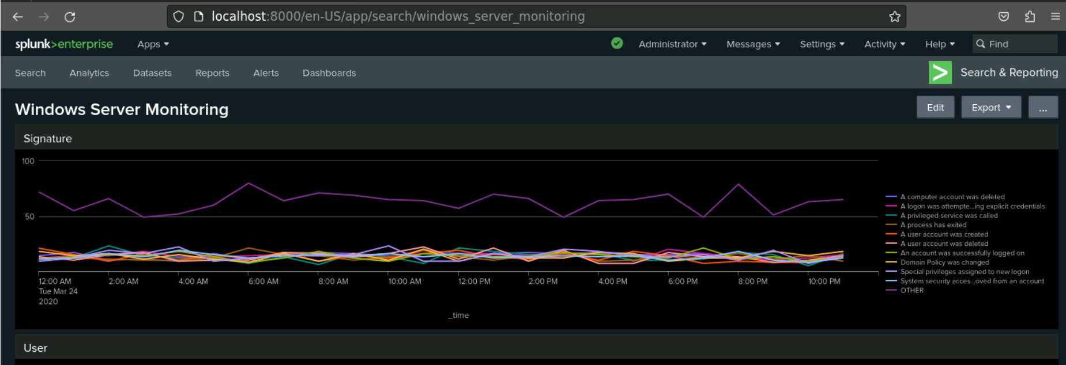
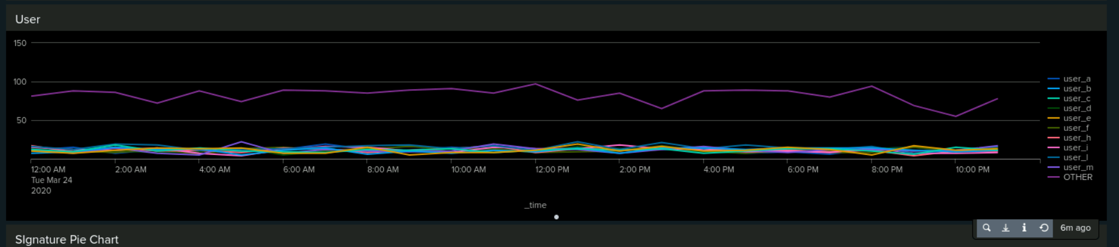
Dashboards—Windows

Slide 17
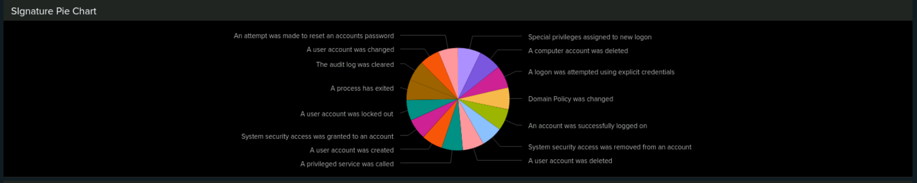
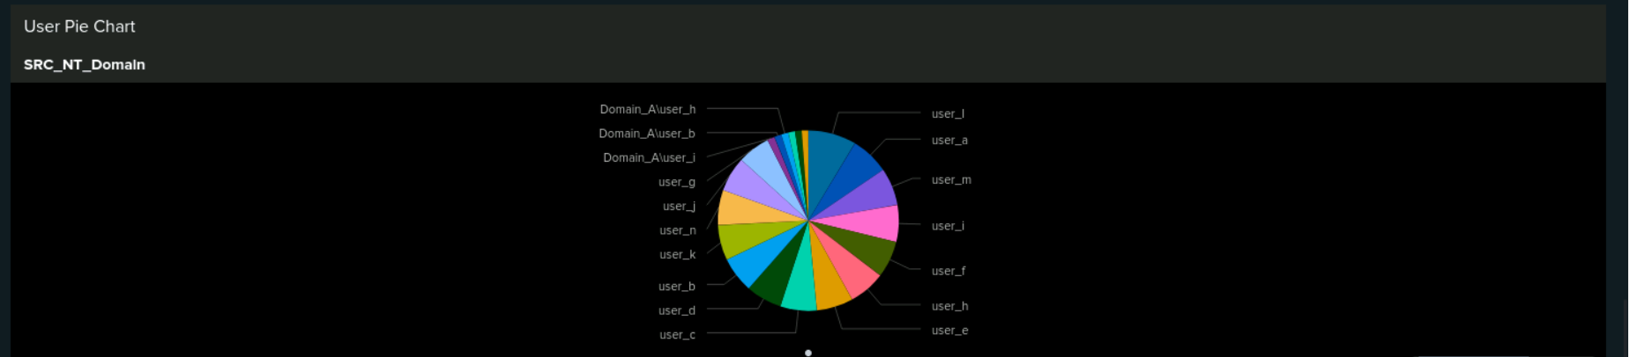
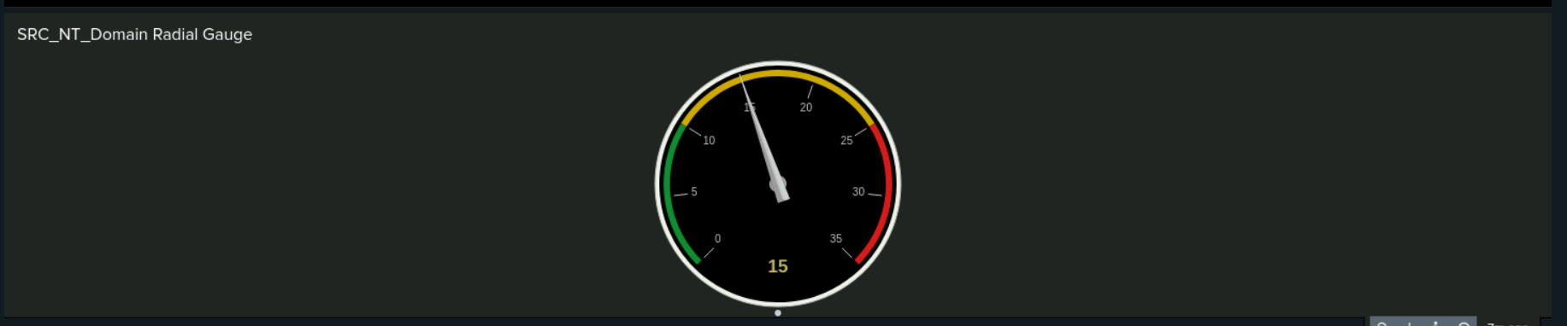
Dashboards—Windows

Slide 18
Apache Logs
‹#›

Slide 19
Reports—Apache
Report Name | Report Description
HTTP Methods | Displays a table of the different HTTP methods (GET, POST, HEAD, OPTIONS)
Referrer Domain | Displays top 10 domains that refer to VSI’s website
HTTP Response Code | Displays count and percentages of different response codes

Slide 20
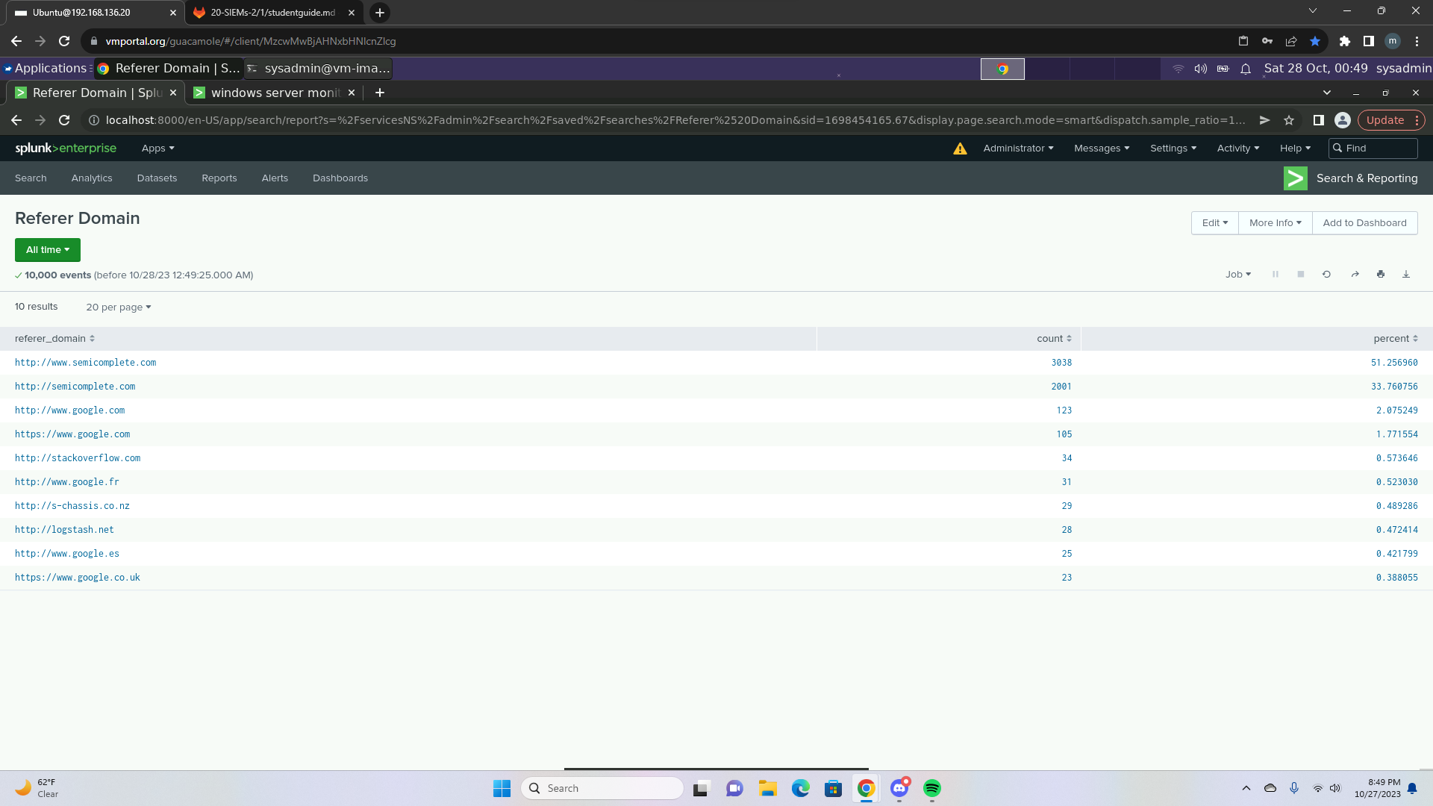
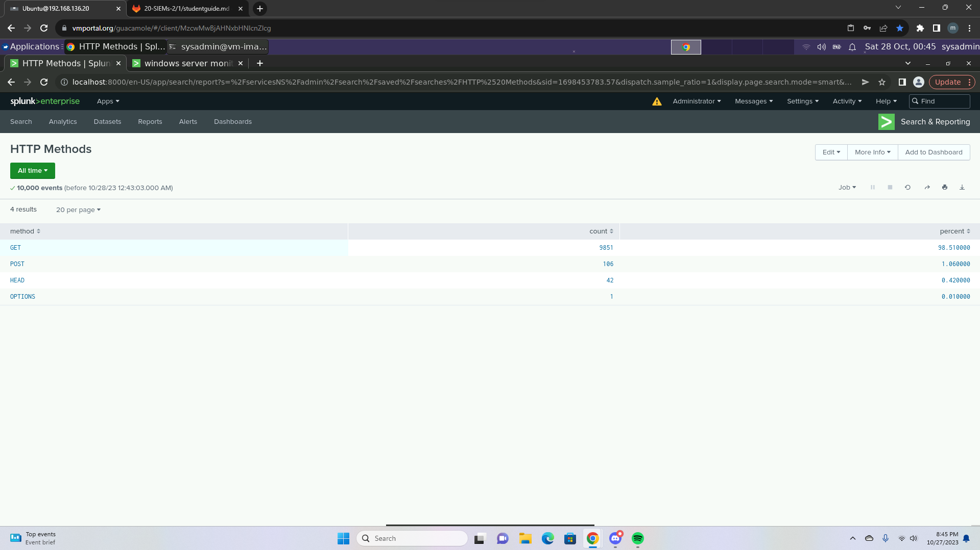
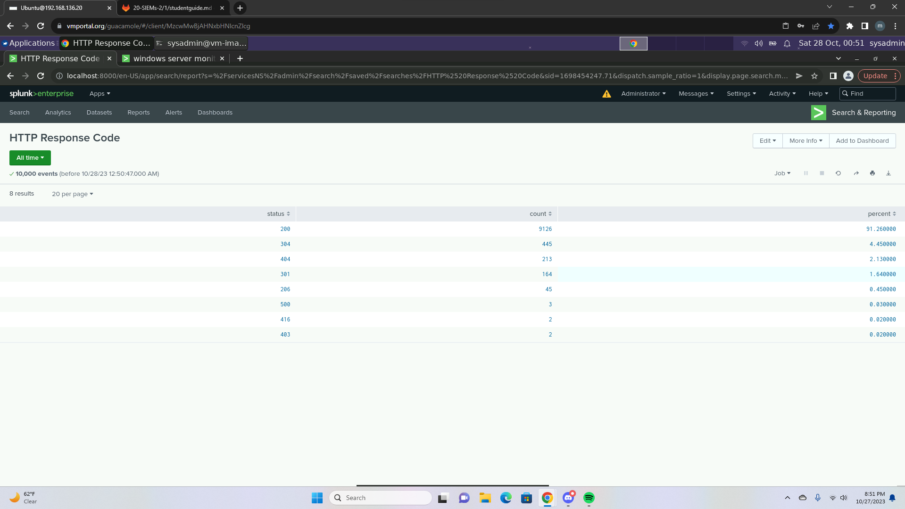
Images of Reports—Apache

Slide 21
Alerts—Apache
Designed the following alerts:
Alert Name | Alert Description | Alert Baseline | Alert Threshold
Alert_ClientIP | The alert will trigger when an IP address is connected outside the United States. | 125 | 160
JUSTIFICATION: The normal baseline activity for the activity from any country outside the United States was about 125. We set the alert to anything over 160 in order to avoid getting fault alarms.

Slide 22
Alerts—Apache
Designed the following alerts:
Alert Name | Alert Description | Alert Baseline | Alert Threshold
HTTP POST Alert | This alert will trigger once the events reach the threshold | 6 | 15
JUSTIFICATION: The average activity of events per hour ranged from 4-7 events. We wanted to avoid alert fatigue by setting the threshold at 15.

Slide 23
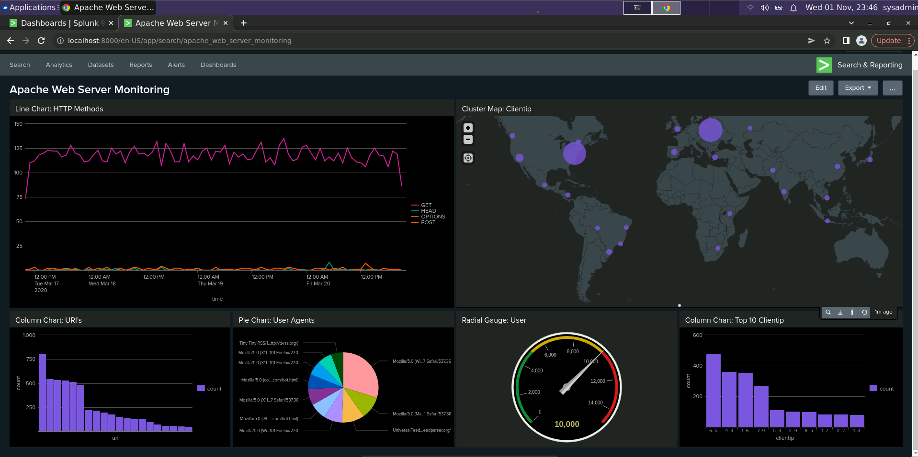
Dashboards—Apache

Slide 24
Attack Analysis
‹#›

Slide 25
Attack Summary—Windows
Summarize your findings from your reports when analyzing the attack logs.
While analyzing the reports for the attack logs there was a major increase in successful user logins, attempts to reset user passwords, and user lockouts. Given this information we were able to come to a conclusion that the adversary was performing a brute force attack while a lot were unsuccessful there were also many users accounts that were compromised. Once the adversary successfully logged into the user account there were many attempts at resetting the users passwords. Severity levels were also impacted from this attack, increasing the high severity level count from 329 to 1111.

Slide 26
Attack Summary—Windows
Summarize your findings from your alerts when analyzing the attack logs. Were the thresholds correct?
While analyzing the alerts for the attack logs there was a major increase in activity at 11:00 AM on Wednesday, March 25 and 12:00 PM that same day. There was a total of 196 events that occurred from 11 AM to 12 PM and a total of 77 events that occurred from 12-1. The user that raised suspicion that was associated with all 196 events was user_j. The threshold for my alert was correct but and it didn’t cause alert fatigue but I would change my threshold from 25 to 50.

Slide 27
Attack Summary—Windows
Summarize your findings from your dashboards when analyzing the attack logs.
Three mains things that we took note of when creating the line chart for signature was the increase in the user account lockout, attempts to reset passwords, and successful logins. Three main users that appeared in the attack were user_a, user_k, and user_j.

Slide 28
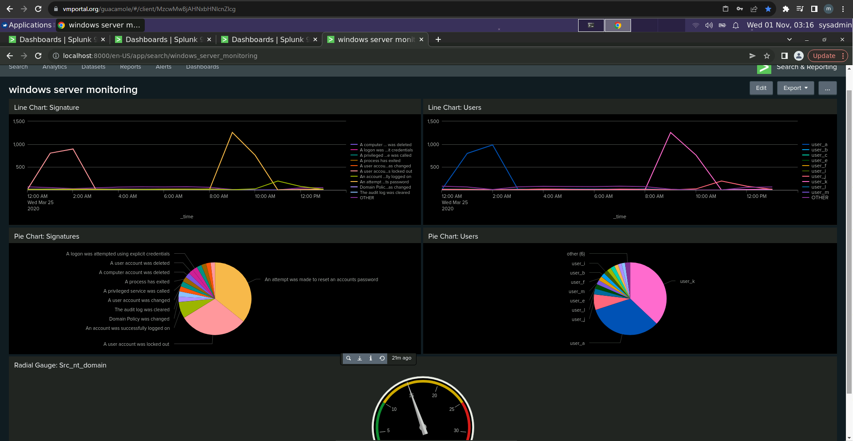
Screenshots of Attack Logs

Slide 29
Attack Summary—Apache
Summarize your findings from your reports when analyzing the attack logs.
Suspicious actions were found in the HTTP method such as post requests were very high and GET requests decreased after the attack.
Referrer domains were subject to suspicious changes. There were unfamiliar domains that appeared in the attack logs and the total count appeared less which show a change in traffic.
There were significant suspicious changes in HTTP response codes such as 200 and 404. There were less 200 response codes and more 404 response codes. It shows that the attacker was requesting for resources that are not available on the host.

Slide 30
Attack Summary—Apache
Summarize your findings from your alerts when analyzing the attack logs. Were the thresholds correct?
There was a high volume of suspicious international activity. The total number of events was 1415 which was at its highest peak than any other time.
An unusually high amount of HTTP POST activity was discovered. The total number of HTTP POST requests was at its highest.
It had a total of 1296 events

Slide 31
Attack Summary—Apache
Summarize your findings from your dashboards when analyzing the attack logs.
The HTTP POST method was used significantly during the attack.
It’s highest peak during the attack was at 1296 which lasted 2 hours.
Unusual amount of high activity was detected in Ukraine which was 1753.
There was high volume activity for the VSI account logon.

Slide 32
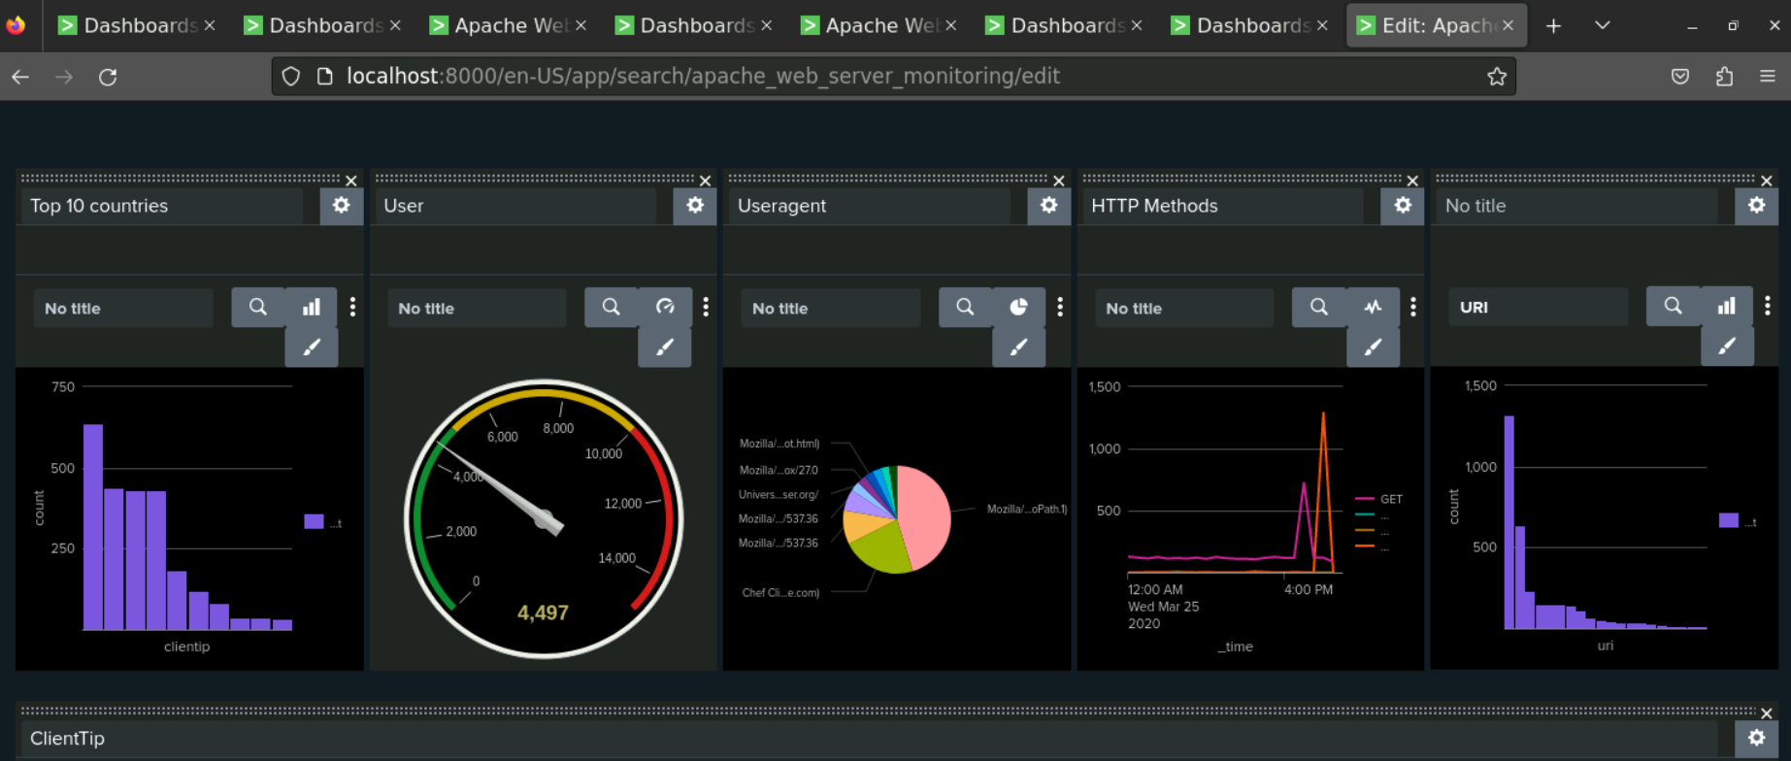
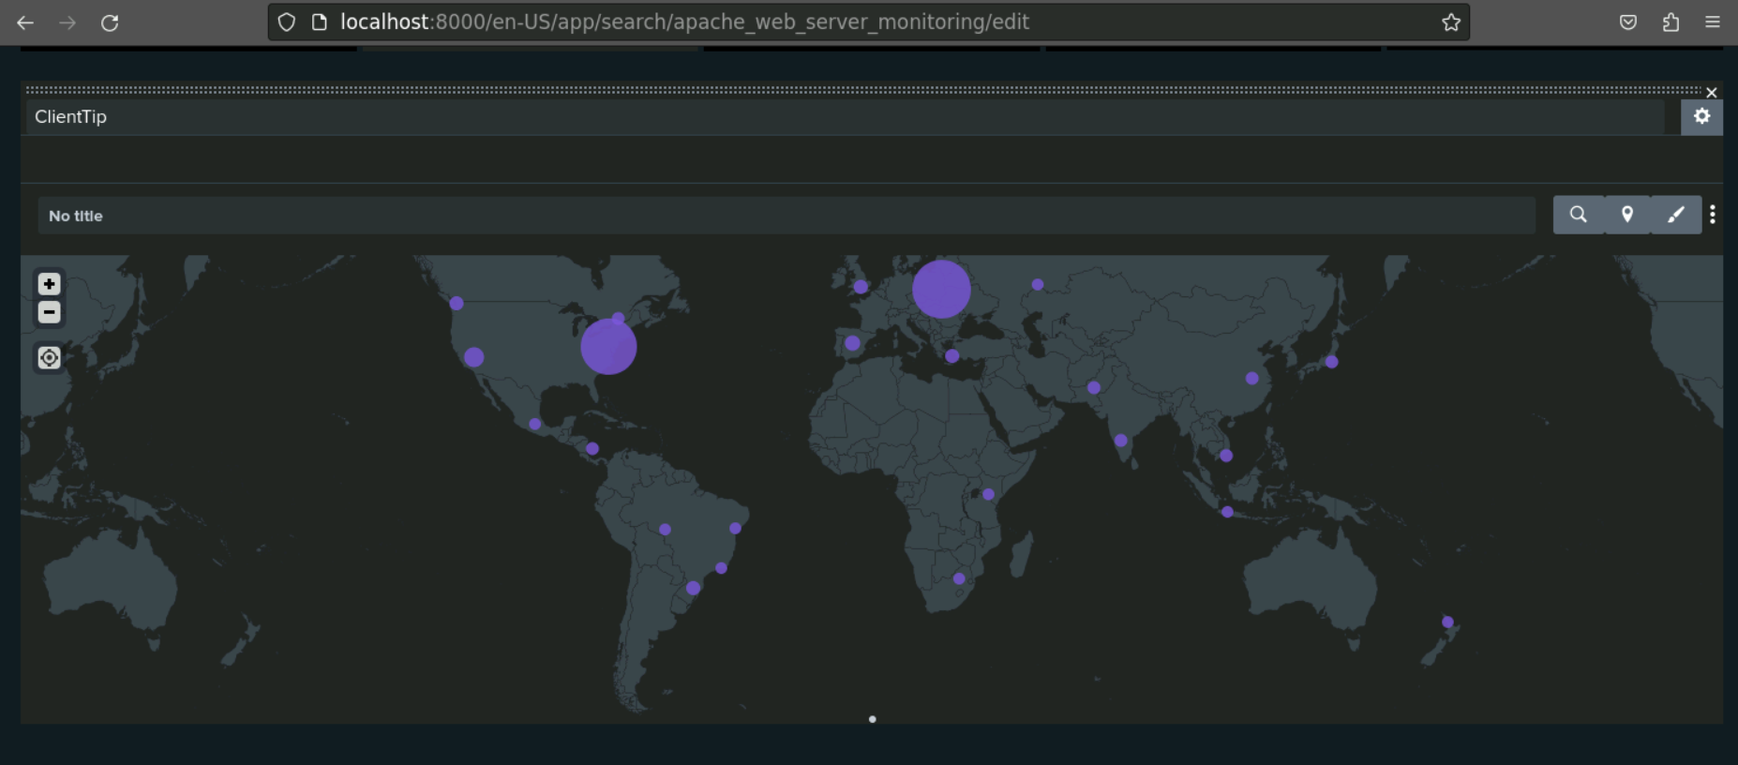
Screenshots of Attack Logs

Slide 33
Summary and Future Mitigations
‹#›

Slide 34
Project 3 Summary
What were your overall findings from the attack that took place?
Attacker used a brute force attack to compromise the company by gaining the user’s credentials.
Attacker attempted to reset the users’ passwords so they can’t log back in.
We believe the attacker took down a couple of web applications from the increase in 404 response codes.
To protect VSI from future attacks, what future mitigations would you recommend?
In order to prevent these attacks from happening again we would need to strengthen the users’ passwords to make it difficult for a threat actor to use a brute force attack.
Configure a firewall to block certain traffic.
Multi-factor authentication

